Slide 1
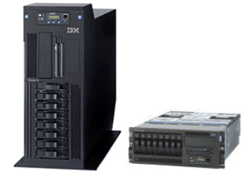
BCI433 – IBM Business Computing
Lecture 1
Introduction to IBM Systems

Slide 2
Agenda
Course Description
Credits
Learning Outcome
Tests and Assignment
Brief History of IBM AS/400 System I or iSeries
Lec # 1
Lab # 1 (Pending AS/400 IDs)

Slide 3
Course Description
This course introduces business information technology on the IBM midrange family of computers running the IBM i operating system.
Students will utilize an object-based architecture using IBM i tools to create business applications.
These applications will be developed using the DB2 relational database, Control Language commands and programming, and the business-oriented RPGLE programming language.
To demonstrate the heterogeneous systems support available on the IBM i platform, students will investigate the Integrated File System, which supports non-native file systems, desktop connectivity tools, and support for mobile application development.
Course Outline https://www.senecacollege.ca/ssos/find/BCI433/current/ce

Slide 4
Credits
Required for
CPA - Computer Programming and Analysis (Ontario College Advanced Diploma)
CPD - Computer Programmer (Ontario College Diploma)

Slide 5
Learning Outcome
Upon successful completion of this subject the student will be able to:
Use IBM’s object-based operating system to create, house and manage enterprise applications.
Apply IBM i security commands to ensure that IBM i databases and libraries are protected.
Apply IBM application development tools and RPGLE programming language when developing business applications.
Create a simple mobile application that runs on IBM i to demonstrate tool effectivity (Optional)
Use the system command language to run and manage business applications as batch and interactive jobs that utilize resources efficiently.
Embed structured query language statements in application development programming code .
Use IBM i operating system menus and create custom user menus.

Slide 6
Test and Assignment
2 Assignment – 30 %
2 Tests – 35 %
6 or 7 Labs – For Practicing (No marks)
Exam – 35 %
Total - 100 %

Slide 7
Week # 1- Agenda
Introduction and MochaSoft Software TN5250 Emulator
iSeries Operating System Overview
Sign on process
User Profile
Navigation
iSeries HELP – F1
Control Language (CL)
System Values
Queues

Slide 8
Week # 1- Introduction
E-mail: azmat.bhatti@senecacollege.ca
iSeries Emulator: http://www.mochasoft.dk

Slide 9
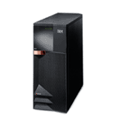
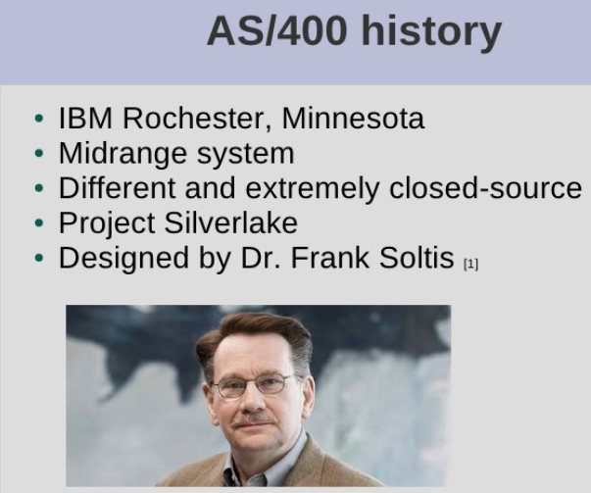
Week # 1- Overview of the iSeries-AS/400
Developed by IBM to support medium to large scales business
i means “integration”
- A server designed for the on demand challenges of Web and e-business, as well as core On-line Transaction - Processing (OLTP) workloads, with support for multiple operating and application environments.

Slide 10
AS/400 and iSeries are reference to older versions of the Hardware/Software
Current Operating System is IBM i
Current Hardware is POWER - Performance Optimization With Enhanced Risc
You are working on an IBM i operating system on POWER

Slide 11
Week # 1- History of AS/400
System 3
1969 - 1985
System 32
1975 - 1984
System 34
1977 - 1985
1983 - 1994
System 36
System 38
1980 - 1994
AS/400
1988 - present
iSeries
2000 - present
system i
2005 - 2006
i
2007
Power Systems
2008

Slide 12
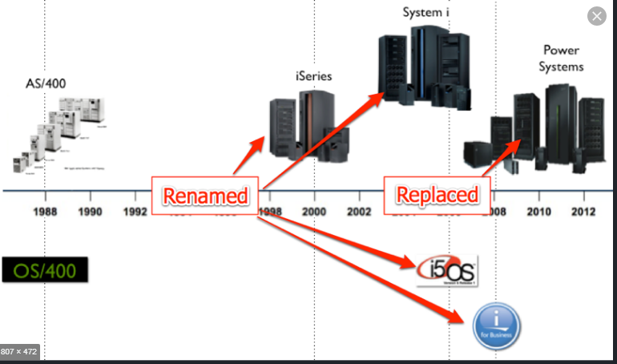
POWER Systems Heritage

Slide 13
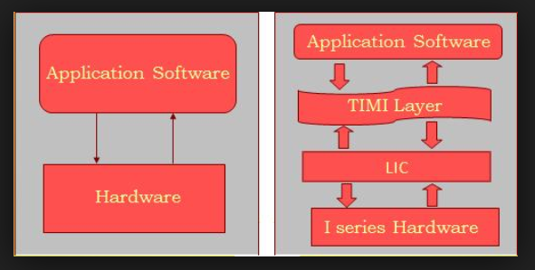
Overview of the iSeries-AS/400 - The Architecture
Operating System
Database
Compiler
Sub-System
Hardware
Software
License Internal Programs (LIC)
Logical Partitioning LPAR

Slide 14
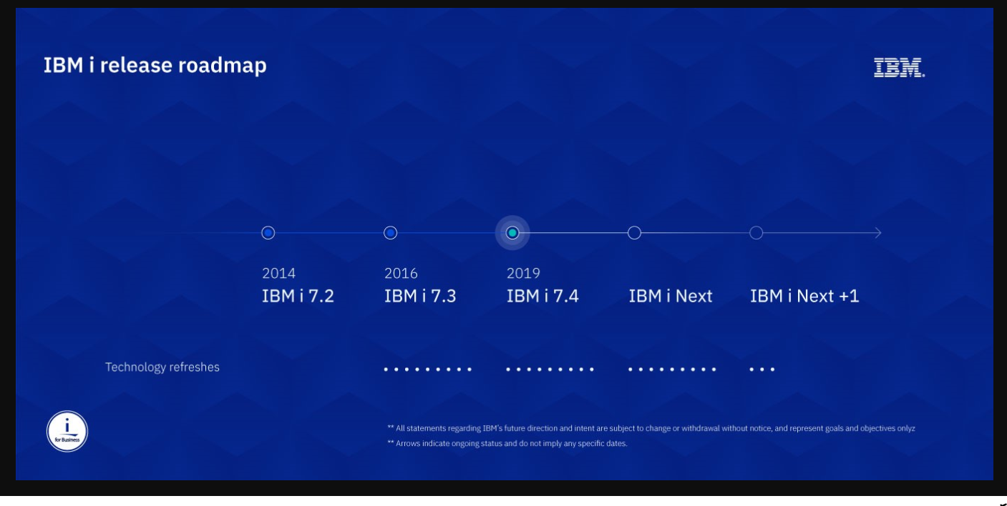
Overview of the iSeries-AS/400 – Server Roadmap

Slide 15
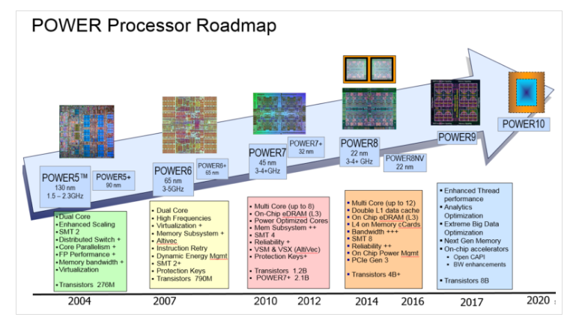
Overview of the iSeries-AS/400 - Roadmap

Slide 16
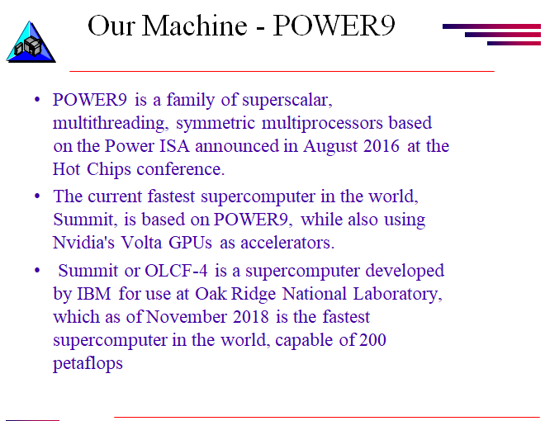

Slide 17
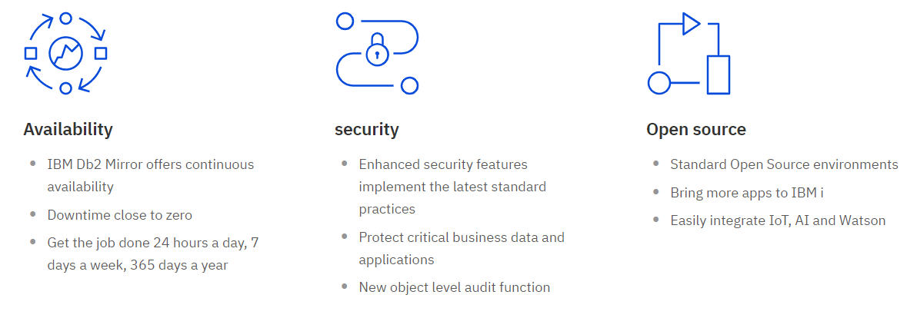
Latest Features of IBM i

Slide 18
Overview of the iSeries-AS/400 - The Environment
Native Environment
Operating system: IBM I
Database: DB2/400
SQL
Database: DB2/400
AIX
Integrated File Structure
Linux
Integrated File Structure
Redbooks(Online Guide)
http://www.redbooks.ibm.com/redbooks.nsf/searchsite?SearchView&query=%22IBM+i%22

Slide 19











Week # 1- Overview of the iSeries-AS/400
iSeries –
Robust, Complex, Multi-user, Multi-tasking Mid-range platform, functionally rich set of programs. It Controls traditional computer system functions.
Primarily Green Screen/text-based presentation
iSeries Model 820 supports Logical Partitioning environments (LPAR)
Supports RPG, COBOL , 'C', JAVA and other programming Languages
User Profiles provide 'environment' for a User I.D. to sign on and run jobs
OS/400 is the AS/400’s operating system
It supports two other operating systems – System/36 and System /38

Slide 20
Overview of the iSeries-AS/400
Options & Function Keys are available to initiate tasks (demo)
Alternate Sign-on Access is an option of the Operating System (demo)
Navigation is typically via Menus and/or the Command Line (demo)
Operations Navigator is a GUI Interface to the iSeries platform (see http://www.ibm.com/eserver/iseries/navigator/ (demo)
Environments (Sub-systems) are created to run Jobs (web)

Slide 21
Overview of the iSeries-AS/400
OS/400 also supports S/36 & S/38 O/S environments (former release levels)
Objects on the iSeries are identified by their TYPE (web)
CL Commands (provided by OS/400) allow user tasks to be run (demo)
Text-based HELP panels are always available thru F1 (demo)

Slide 22
Overview of the iSeries-AS/400
Rational Developer for system i (RDI)
Development Environment
Download from ACS site
Client Access
Production Environment
Download from ACS site
Downloads available at:
Seneca ITS website (iseries tab)
Models
https://www.ibm.com/support/knowledgecenter/en/POWER5/iphc5/iseries_modelnumbersandnames.htm

Slide 23
Commonly Used Function Keys
F1 = Help
F2 = Extended Help
F3 = Exit
F4 = Prompt
F5 = Refresh Screen
F9 = Retrieve Previous Command
F12 = Cancel
F23 = More options
F24 = more function keys

Slide 24
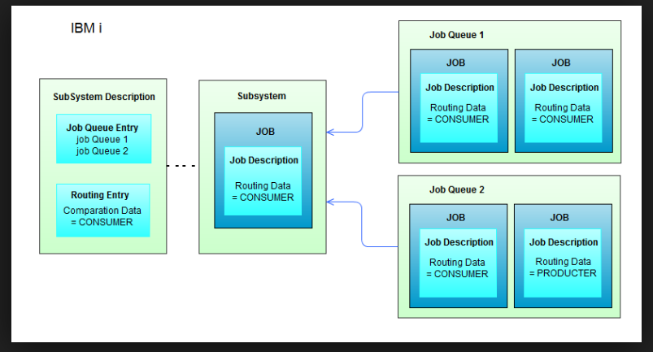
Week # 1 - Sub Systems
All jobs are run in areas of the computer called Sub systems.
A Sub system is where the system brings together the resources needed to process work.
Sub system characteristics determine how the system uses resources within the Sub system.
The AS/400 operating system supports multiple Sub systems that can be User-defined, each having a separate Sub system description.

Slide 25
Week # 1 - Sub Systems (continued)
Some attributes of Sub systems whose values are defined in the Sub system description include:
Sub system name Qinter, Qbatch, Qspl
How many jobs can run in a Sub system at one time
Which storage pools the Sub system will use
Which job queues the Sub system will work from

Slide 26
Week # 1 - Sub Systems (continued)
Different Sub systems are necessary because of the many different types of jobs with different characteristics and often conflicting needs.
The system administrator/root admin can tailor the existing Sub system descriptions and create new Sub systems to handle the needs of different types of jobs.
Within Sub systems, individual jobs can be prioritized to begin execution sooner or later and, after they begin, can be given a higher or lower runtime priority.

Slide 27
“What is a Job ?”
A “job” is any and every piece of work on the AS/400.
There are two types of jobs:
Interactive jobs
Login
Running something interactively
Batch jobs
Compile a program
Run a report
Submit overnight backup

Slide 28
“Interactive Jobs”
A job that begins when a user signs on to the system and ends when they sign off.
It is a job with interaction between the user and IBM i, similar to a conversation ( a polite conversation!).
Interactive jobs run in subsystem QINTER
Terminates when the user signs off the AS/400 or the job has ended
Runs in conversational mode (i.e., dialogue of sorts between user and program, utility, or operating-system function)

Slide 29
“Batch Jobs”
A job that runs in the background.
They are generally jobs that use a lot of resources and are lower priority than interactive jobs.
Usually started by interactive jobs e.g. a program compile
Batch jobs run in subsystem QBATCH
Each batch subsystem can execute only a limited number of batch jobs concurrently (This is programmable).
Depending on the settings, a batch job can start right away or wait it’s turn in the queue.

Slide 30
“Batch Jobs”
Batch Jobs:
Can execute without user intervention
Do not require data or any other information to be input through the workstation once they have started
Are sent to a job queue until they can begin execution. A job queue is a staging area, managed by the Sub system, where batch jobs wait in line for their turn at processing.
A typical batch job submission would be a report program or a program compile.
If such a program were run interactively, the DASD (Direct Access Storage Device, or hard disk) access time required could cause the program to run for a long time, locking up the interactive session.

Slide 31
Week # 1 - Types of Jobs (continued)
To minimize disruption of work flow, certain tasks during an interactive session can be sent as batch jobs --
Programmer could submit a compilation or report as a batch job from the interactive job
While the submitted job runs in a batch subsystem, the programmer could go on to other tasks.

Slide 32
Week # 1 Types of Jobs (continued)
An active job can be identified by the Qualified Job Name. A Qualified Job Name is made up of three distinct parts: - Job Name > based on the Terminal I.D.
- User I.D. > The User I.D. that initiated the job. - Job Number > assigned by the system (For a batch job it is the program name)

Slide 33
Work With Active Jobs
Command is WRKACTJOB
Shows you all the jobs that are currently running and their status.
Like Windows Task Manager

Slide 34
Commands in AS/400
Noun + Verb
Such as WRK + ACTJOB or DSP + USRPRF
First part is the action + Next part is the command to search for specific item
Some actions are:
WRK, DSP, PRT, DLT, CHG, RMV, ADD, EDT etc etc
WRK* will bring all commands using a wildcard “*”
Or DSP* etc etc on the command line
Go cmdwrk Go cmddsp etc etc

Slide 35
Week # 1 OS/400
OS/400 is the AS/400’s operating system
It is a robust, complex, functionally rich set of programs
It Controls traditional computer system functions.
It Incorporates features that normally require separate software components
It supports two other operating systems – System/36 and System /38

Slide 36
Week # 1 OS/400 (continued)
All AS/400s are shipped with basic OS/400 support, including predefined system settings for work management functions
System Values WRKSYSVAL or DSPSYSVAL

Slide 37
Week # 1 OS/400 (continued)
OS/400 is an object-based operating system:
An object is anything on the system that has a name and takes up space in storage.
A large number of objects are supplied by IBM through OS/400, and they typically have names beginning with "Q". Other objects usually are named according to shop naming convention.
The system locates an object by its name.

Slide 38
Week # 1 OS/400 (continued)
Objects are grouped into types, and an object type determines how the object is used on the system.
Common types include:
*PGM - Programs
*FILE - Files
*CMD - Commands
* LIB - Library
Other types also include user-profile objects and subsystem-description objects.
Object type is always assigned by the system and is determined by the command used to create the object.

Slide 39
Week # 1 Control Language
OS/400 provides a single, consistent user interface to its functions through Control Language (CL) commands.
CL is flexible, powerful, and allows direct access to OS/400 functions.
More than 1,500 commands are available.
Each command is an object on the AS/400.

Slide 40
Week # 1 Control Language (continued)
Most CL commands consist of a command name and one or more command parameters.
A Command Parameter has an associated value, specified along with a command, that controls and limits the operation of the command and names the files, programs, or other objects the command will work on.

Slide 41
Week # 1 Control Language (continued)
Individual commands can be entered on a command line.
A command line is a line beginning with the symbol ===> that appears near the bottom of certain types of display screens.

Slide 42
Week # 1 - System Values
System values are control and configuration attributes that let you customize certain operating-system functions.
They define critical aspects of the environment and general rules that jobs must follow.
They are not objects.
They describe characteristics of the system that can be displayed or changed with CL commands.
Many come preset or others need to be set.
WRKSYSVAL or DSPSYSVAL commands

Slide 43
System Values (demo)
Data Used to configure the power system for our business needs
Default pre-loaded System Values
Using the command PRTSECATR to review Default/Recommended values by IBM
Tune your system according to your company policies/security audit

Slide 44
User Profiles
Each User ID has a User Profile which describes the user and their authorities
Contains information such as Current Library, default output queue, password, class of user

Slide 45
Queues
A queue is a line-up! A place where things wait.
Examples of IBM i queues:
Job Queues: Where batch jobs wait
Output Queues: Where spool files wait to print
Message Queues: Where messages wait

Slide 46
“Objects”
Any thing on the system that takes up space in “storage”
On Unix/Windows, everything is a file
On iSeries, everything is an object
On Windows, files have extensions (.txt, .doc, xls, .ppt)
On iSeries objects have types
Common object types include:
libraries, files, job, queues, programs

Slide 47
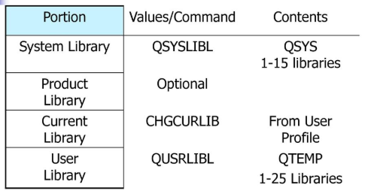
Library List
Like Windows path
Consists of System, User and Program libraries
DSPLIBL, ADDLIBLE, RMVLIBLE, EDTLIBL, CHGCURLIB

Slide 48
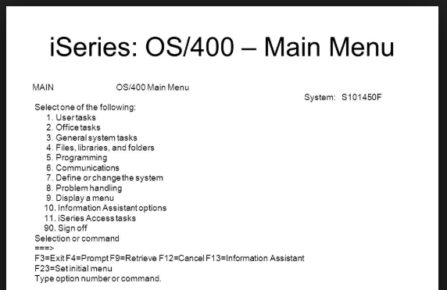
AS/400 Main Menu – Key Items
Menu Name
Menu ID
System ID
Options
Function Keys
Command Line
Message Line

Slide 49
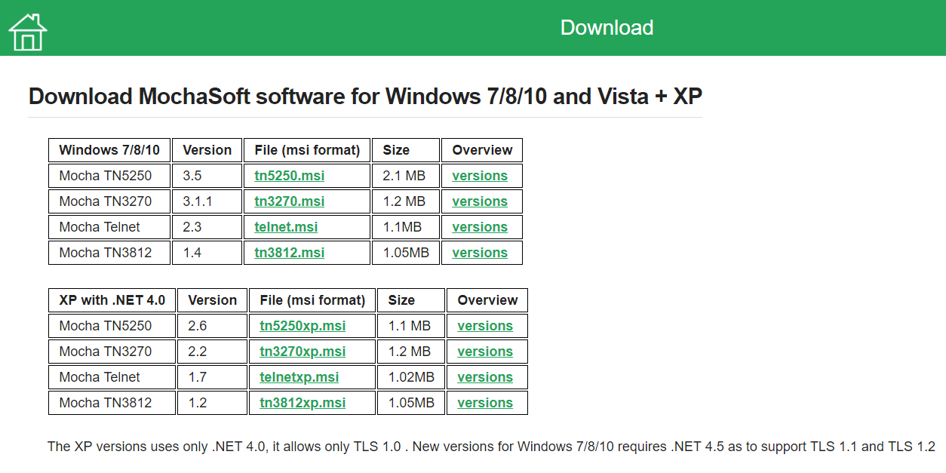
Download Mocha Soft for using AS/400 Emulation TN5250
http://mochasoft.dk/
Download TN5250.msi file for Windows

